Slide 1
VPC PEERING
Connecting two EC2 instances with the help of VPC peering connection.

Slide 2
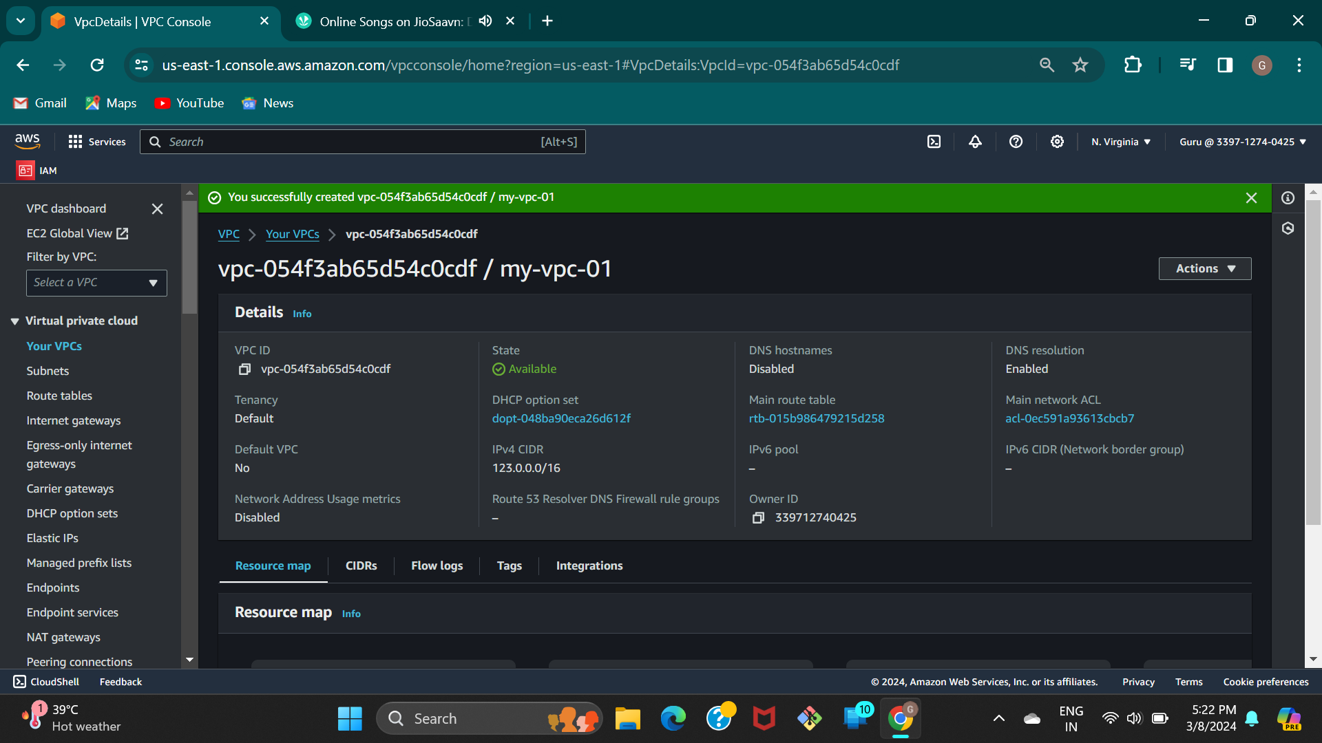
Step 01 :- Create a vpc.

Slide 3
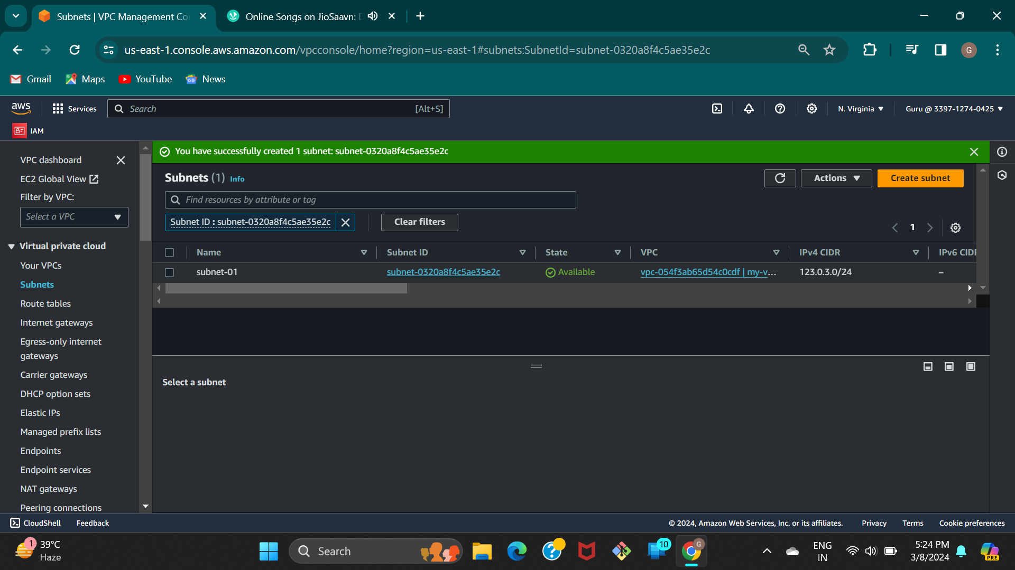
Step 02 :- Create a subnet.

Slide 4
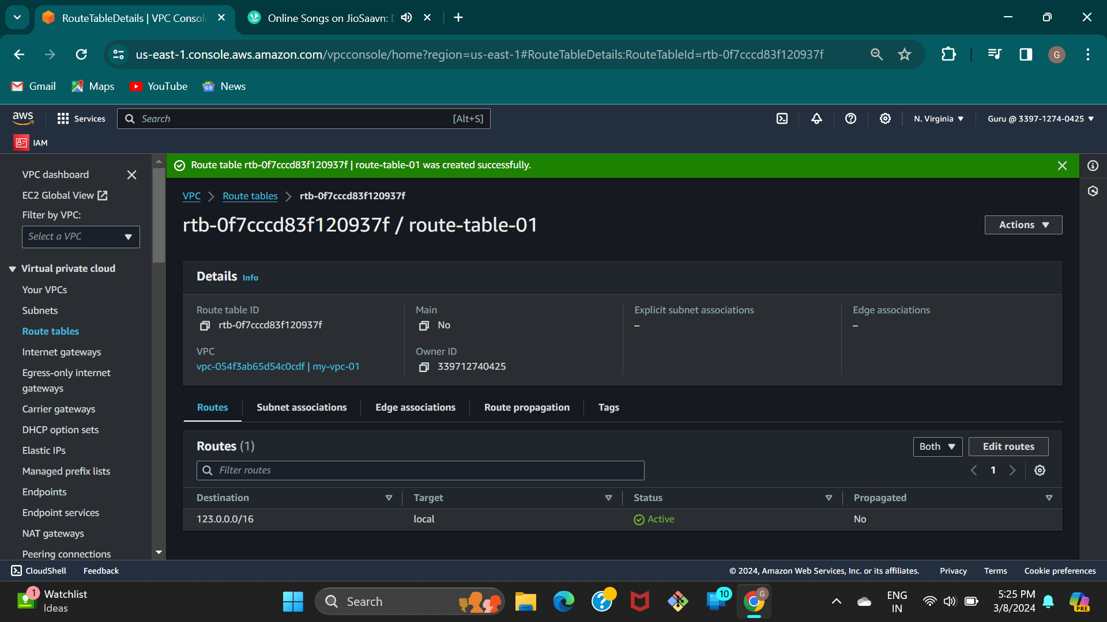
Step 03 :- create a route table.

Slide 5
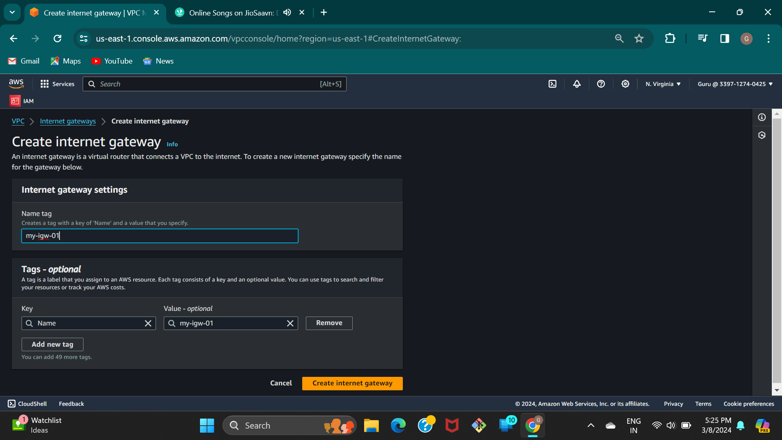
Step 04 :- Creating Internet gateway .

Slide 6
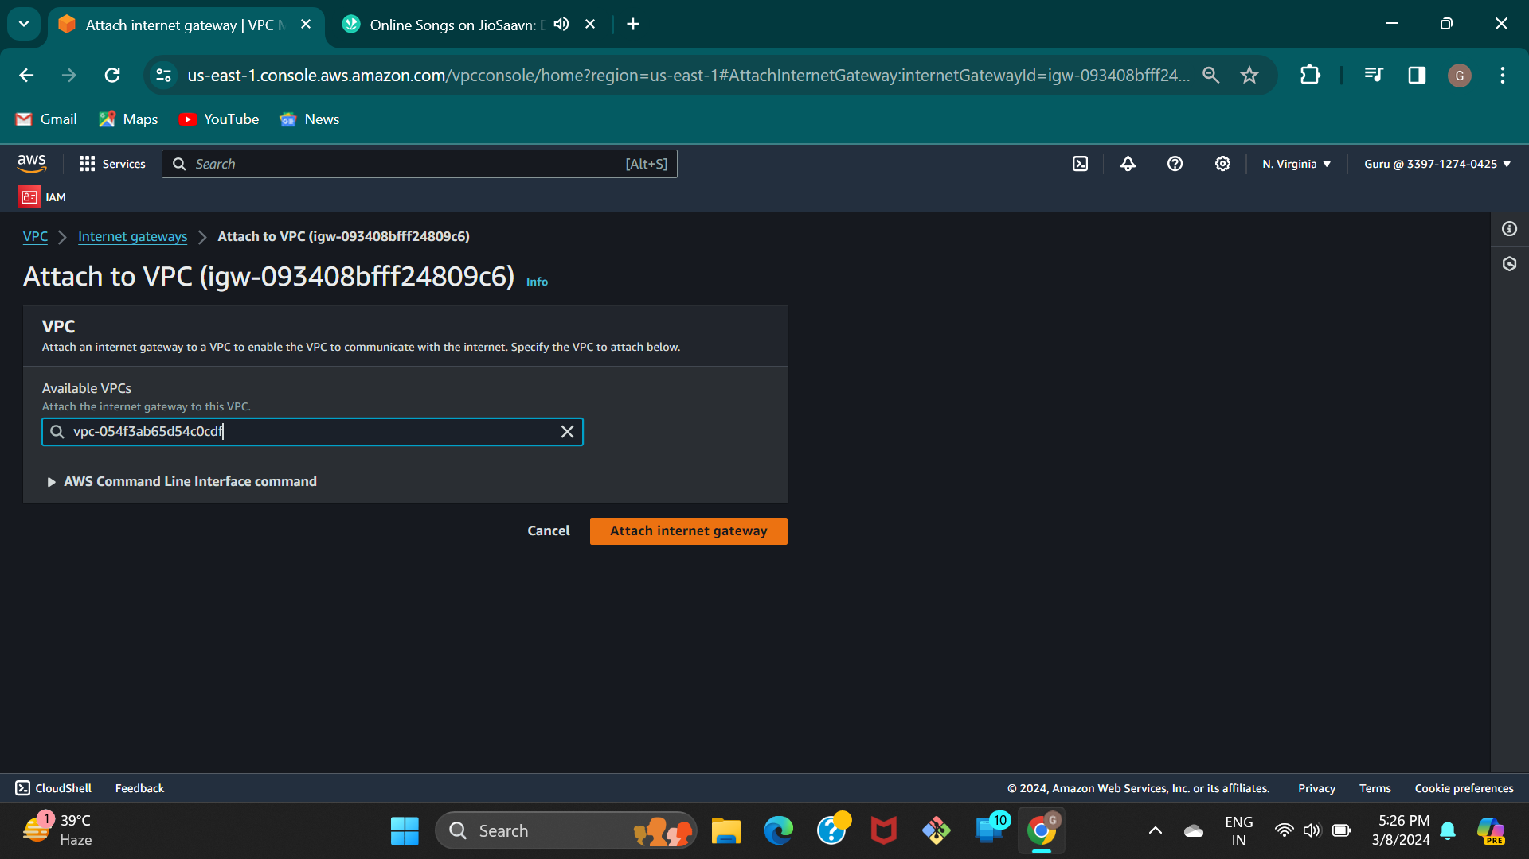
Step 05 :- Attach VPC to the internet gateway.

Slide 7
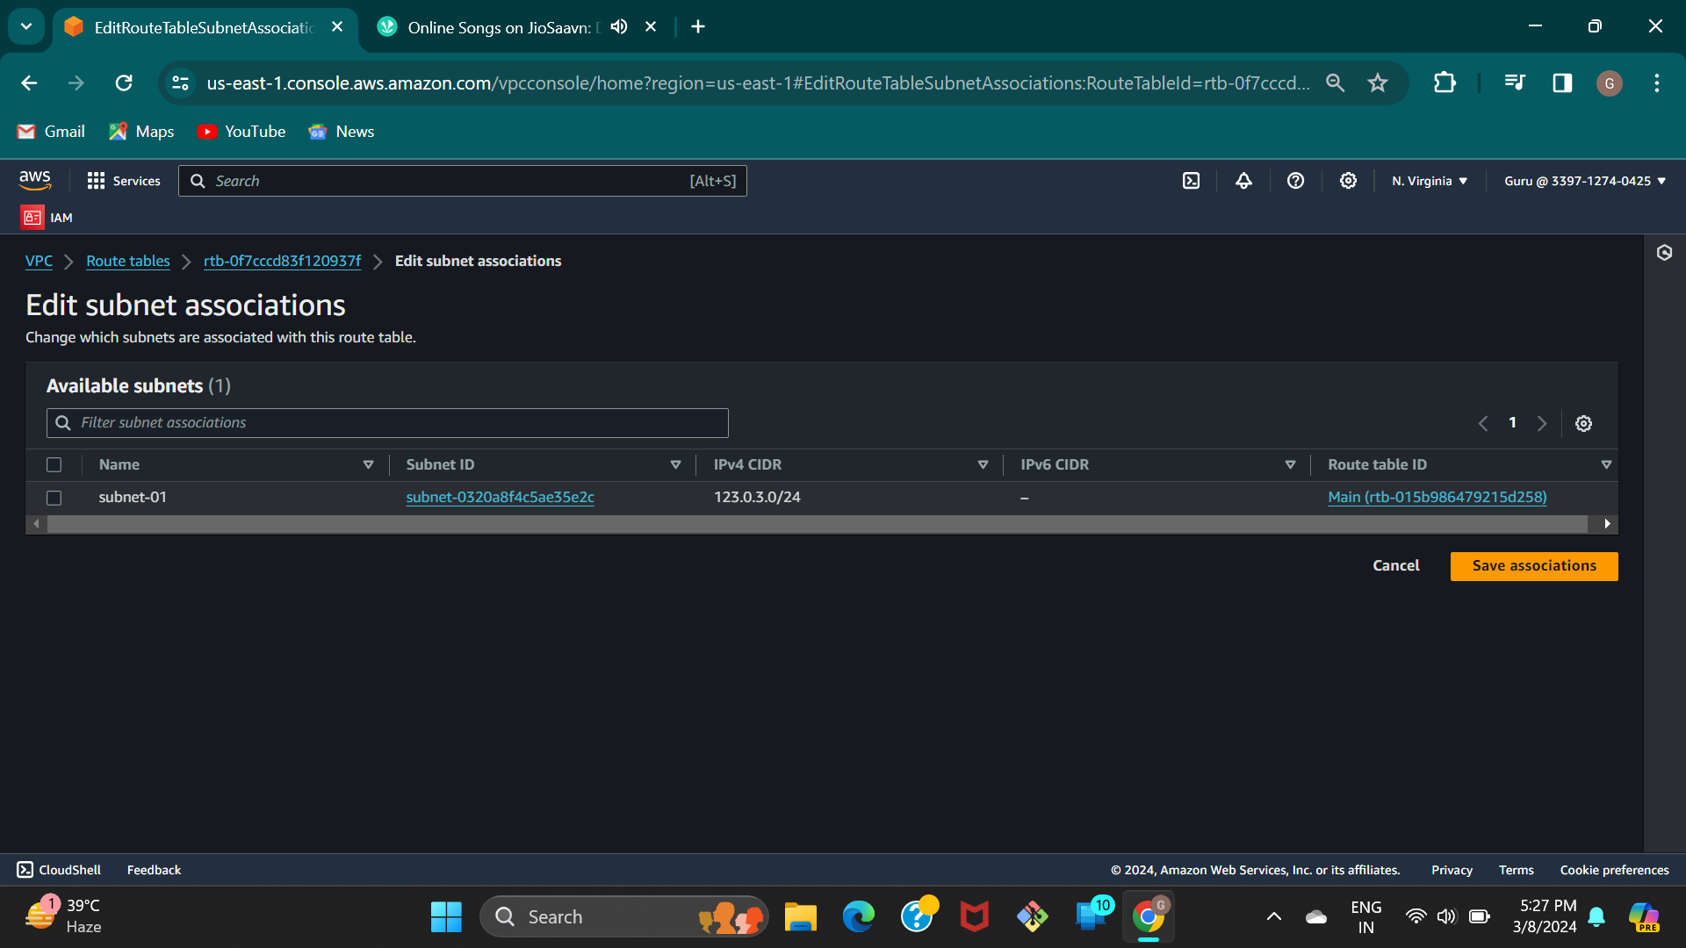
Step 06 :- In the route table ,add subnet 1 to the route table .

Slide 8
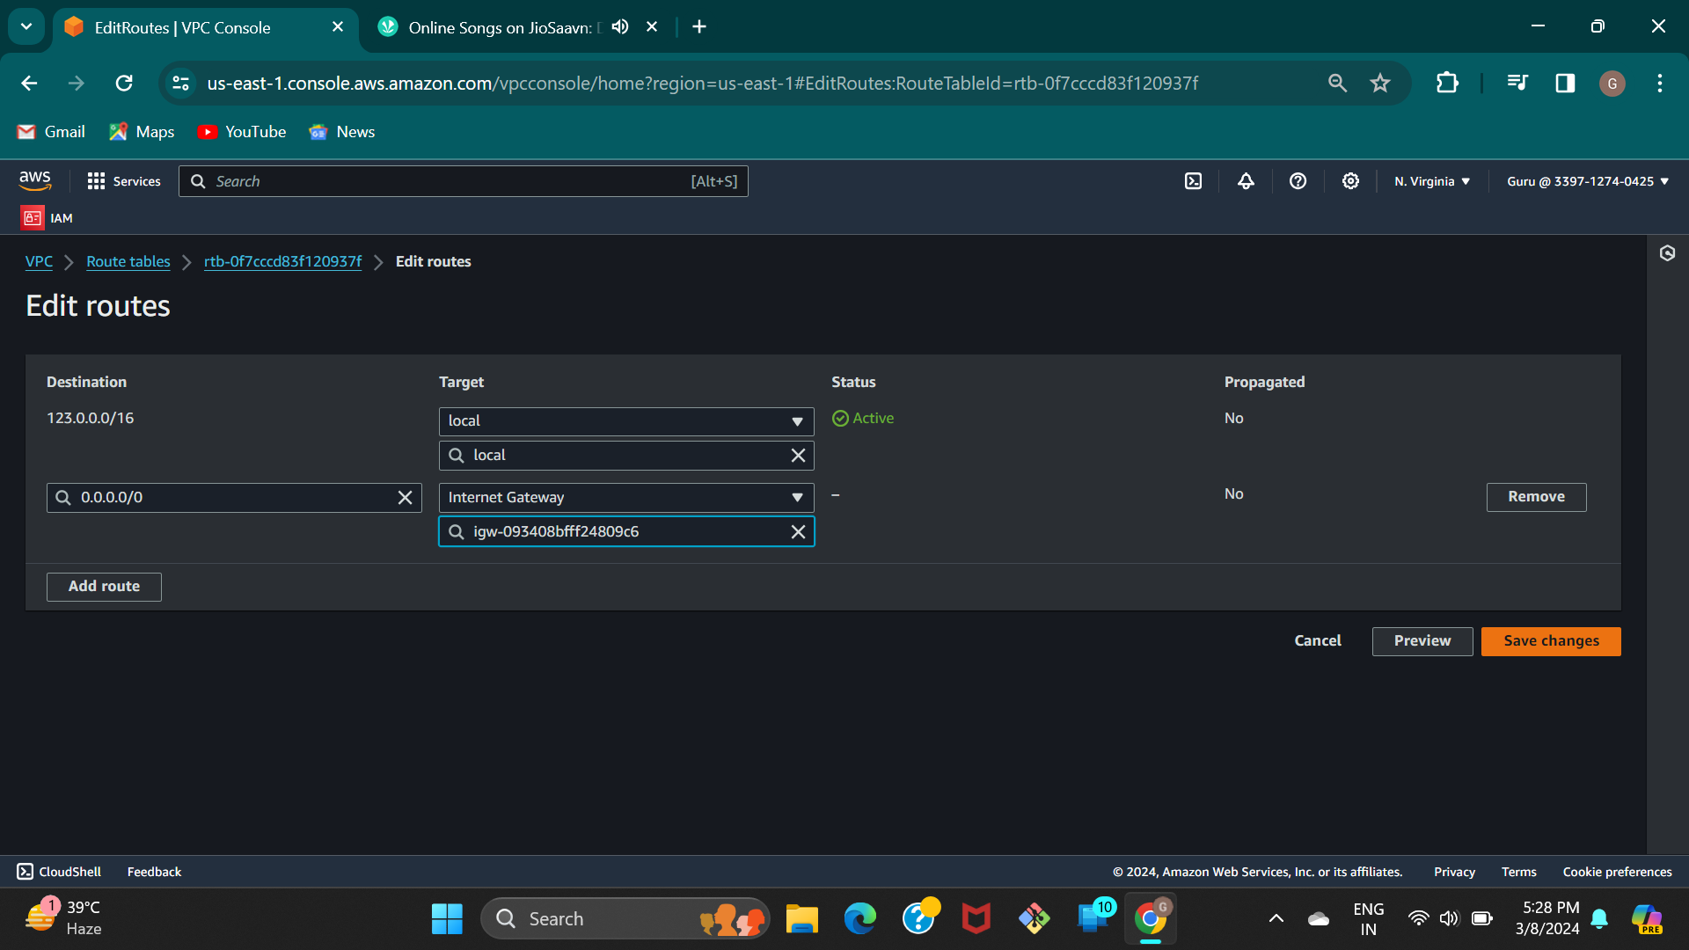
Step 07 :- And also edit the routes in the route table , add internet gateway .

Slide 9
Step 08 :-
Follow the above steps and create one more vpc.(vpc2)
Create another subnet.(subnet-2)
Create a route table.(rt-2)
Create one more internet gateway and attach to vpc2.
Go to route table and edit subnet association and also routes.
Also edit the routes and add the internet gateway.

Slide 10
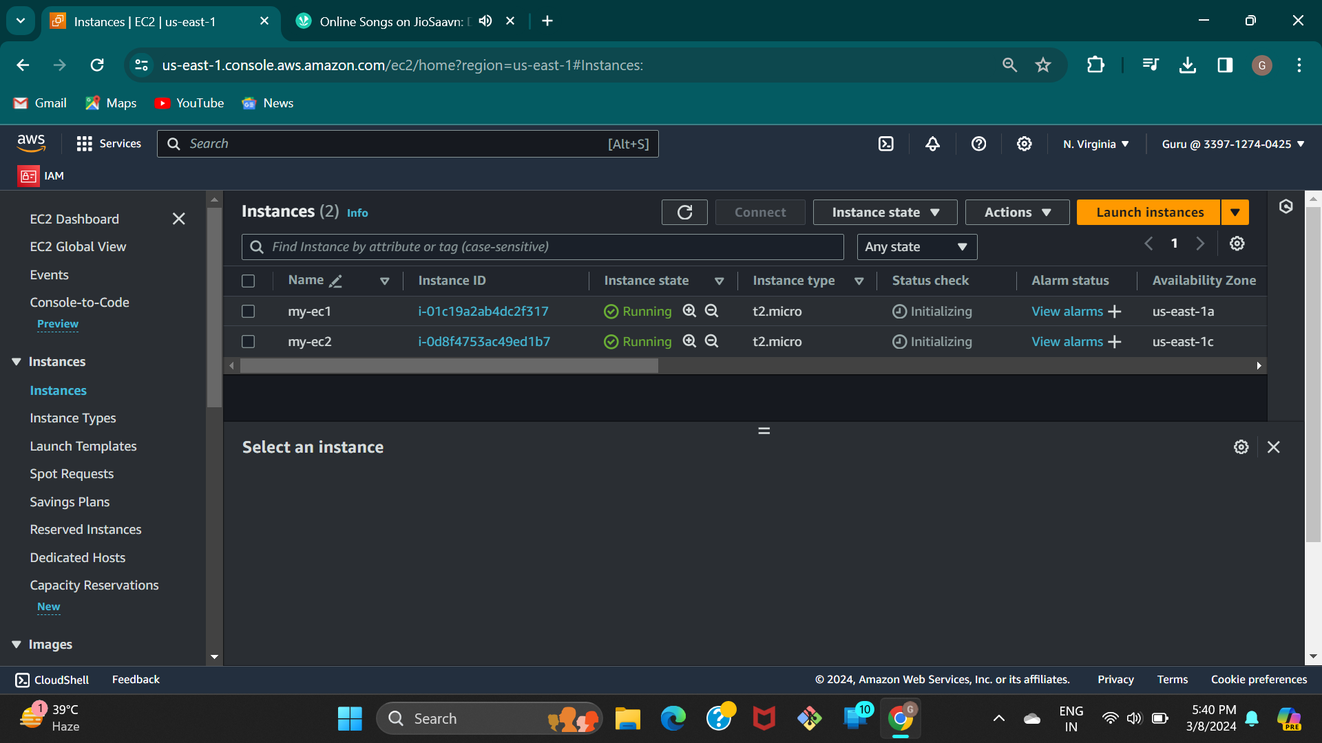
Step 09 :- Create two EC2 instances with different vpc.

Slide 11
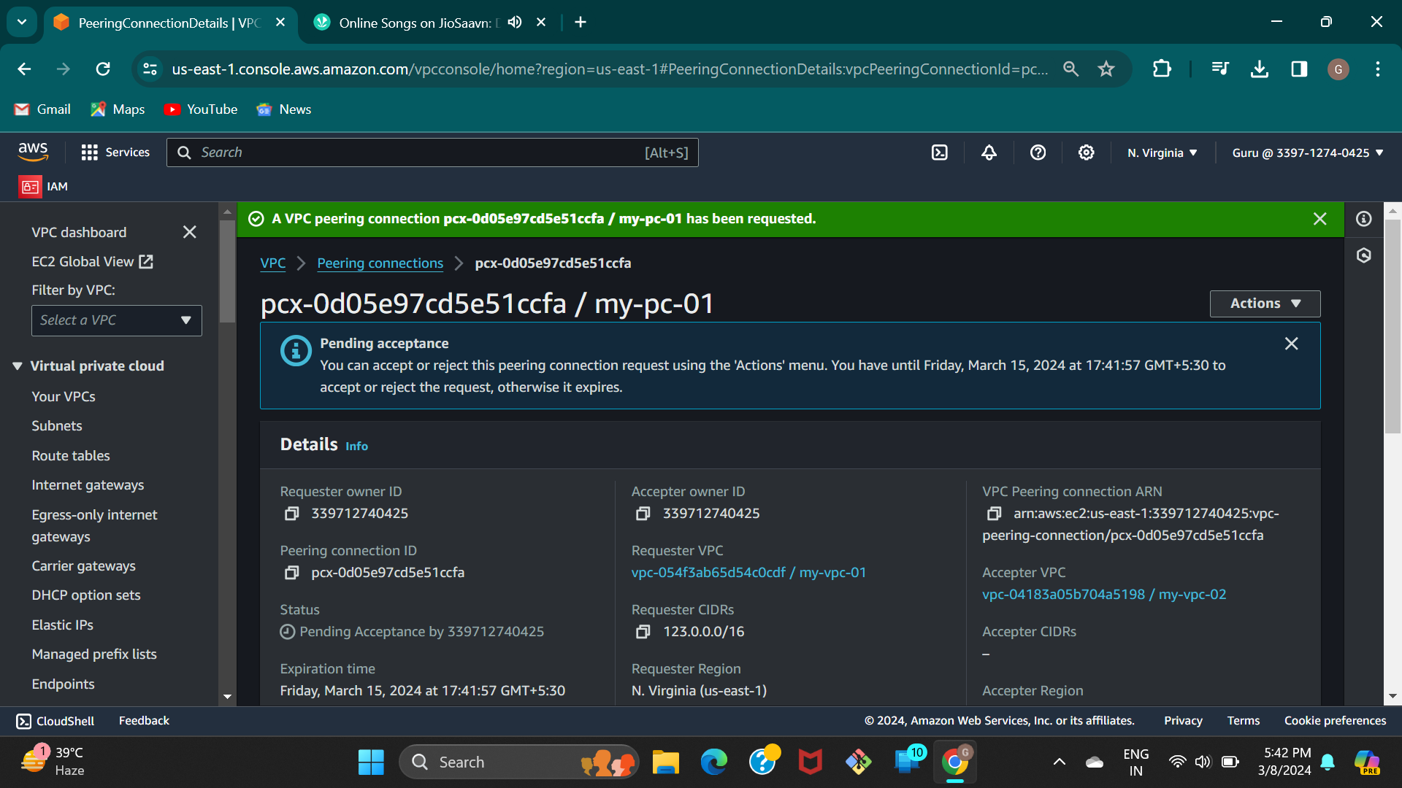
Step 10 :- Create a peering connection.

Slide 12
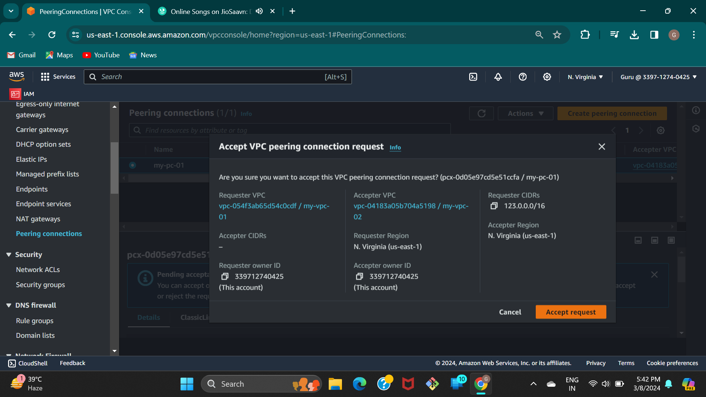
Step 11 :- Accept the peering connection request.

Slide 13
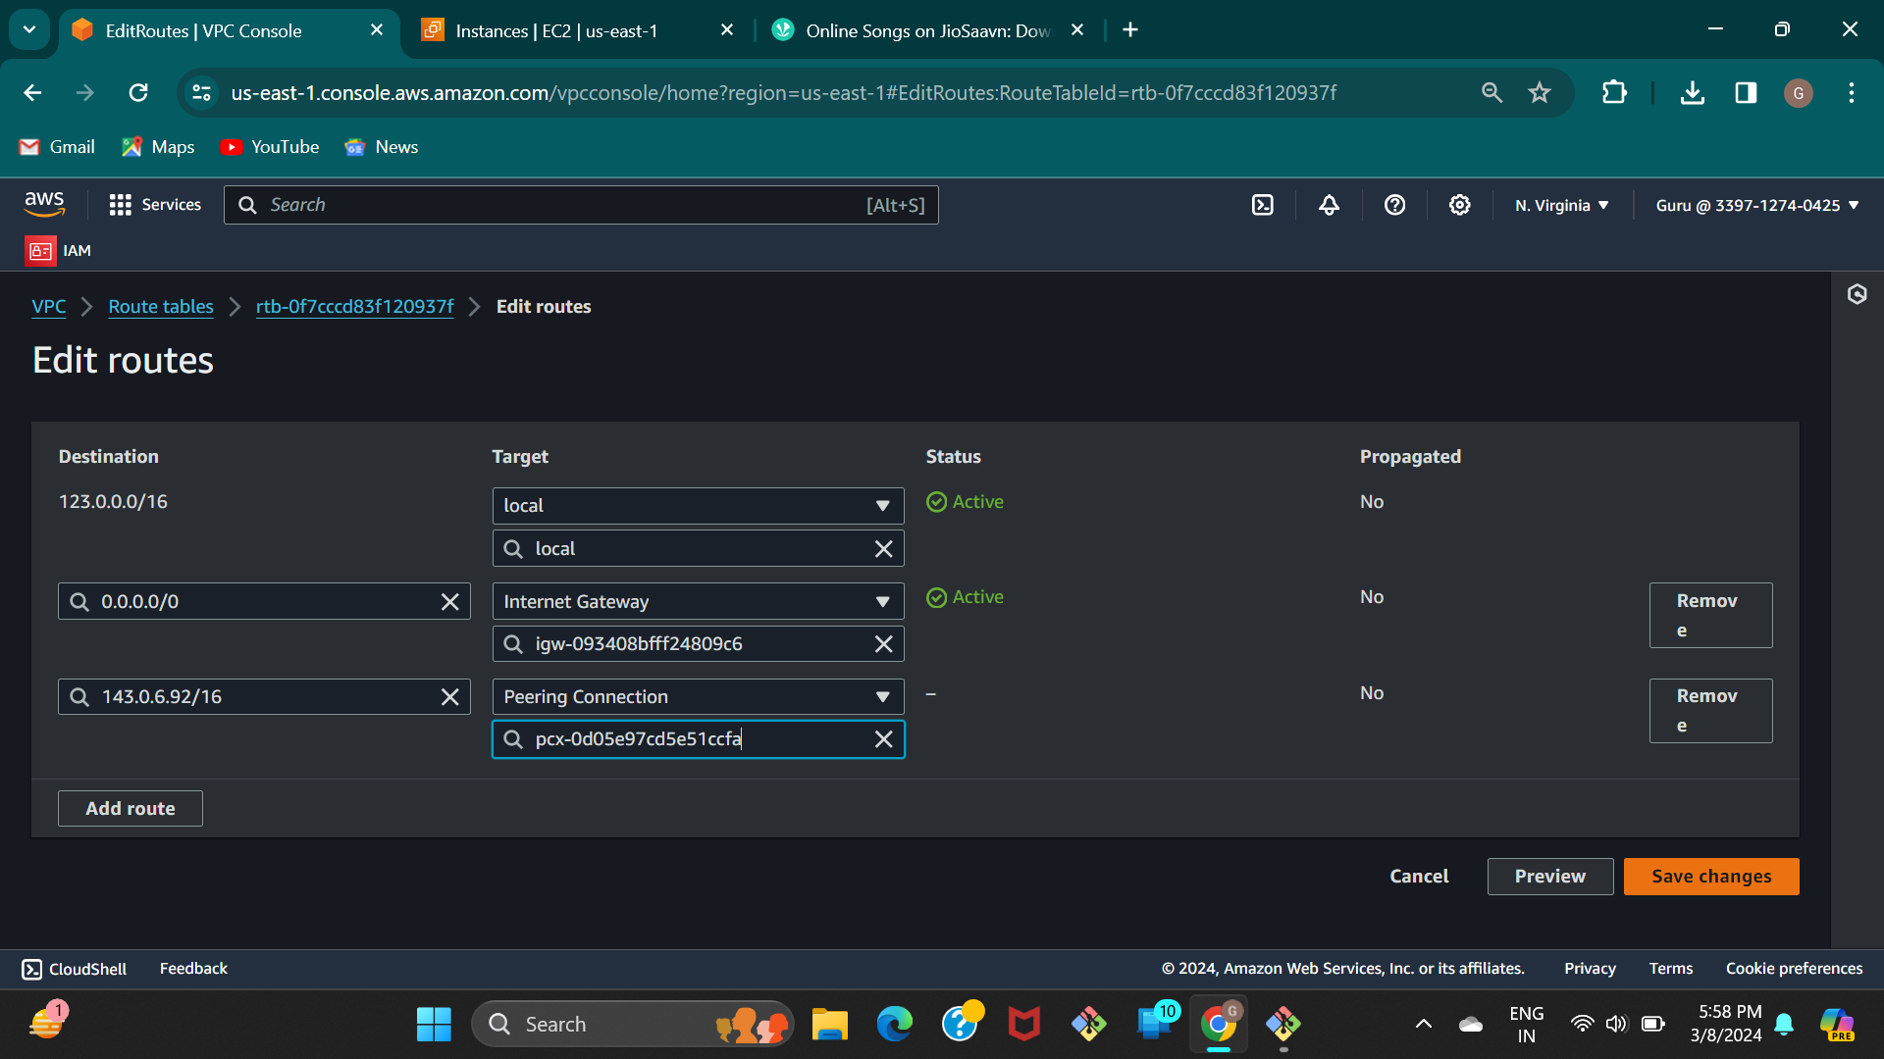
Step 12 :- In the rt 1 edit routes ,add route with second ec2 private ip & peering connection.

Slide 14
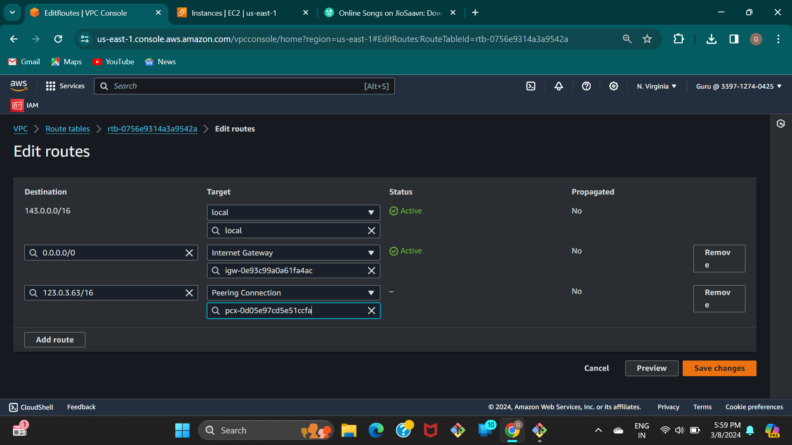
Step 13 :- Do the same thing with first ec2 private ip & peering connection in the second route table.

Slide 15
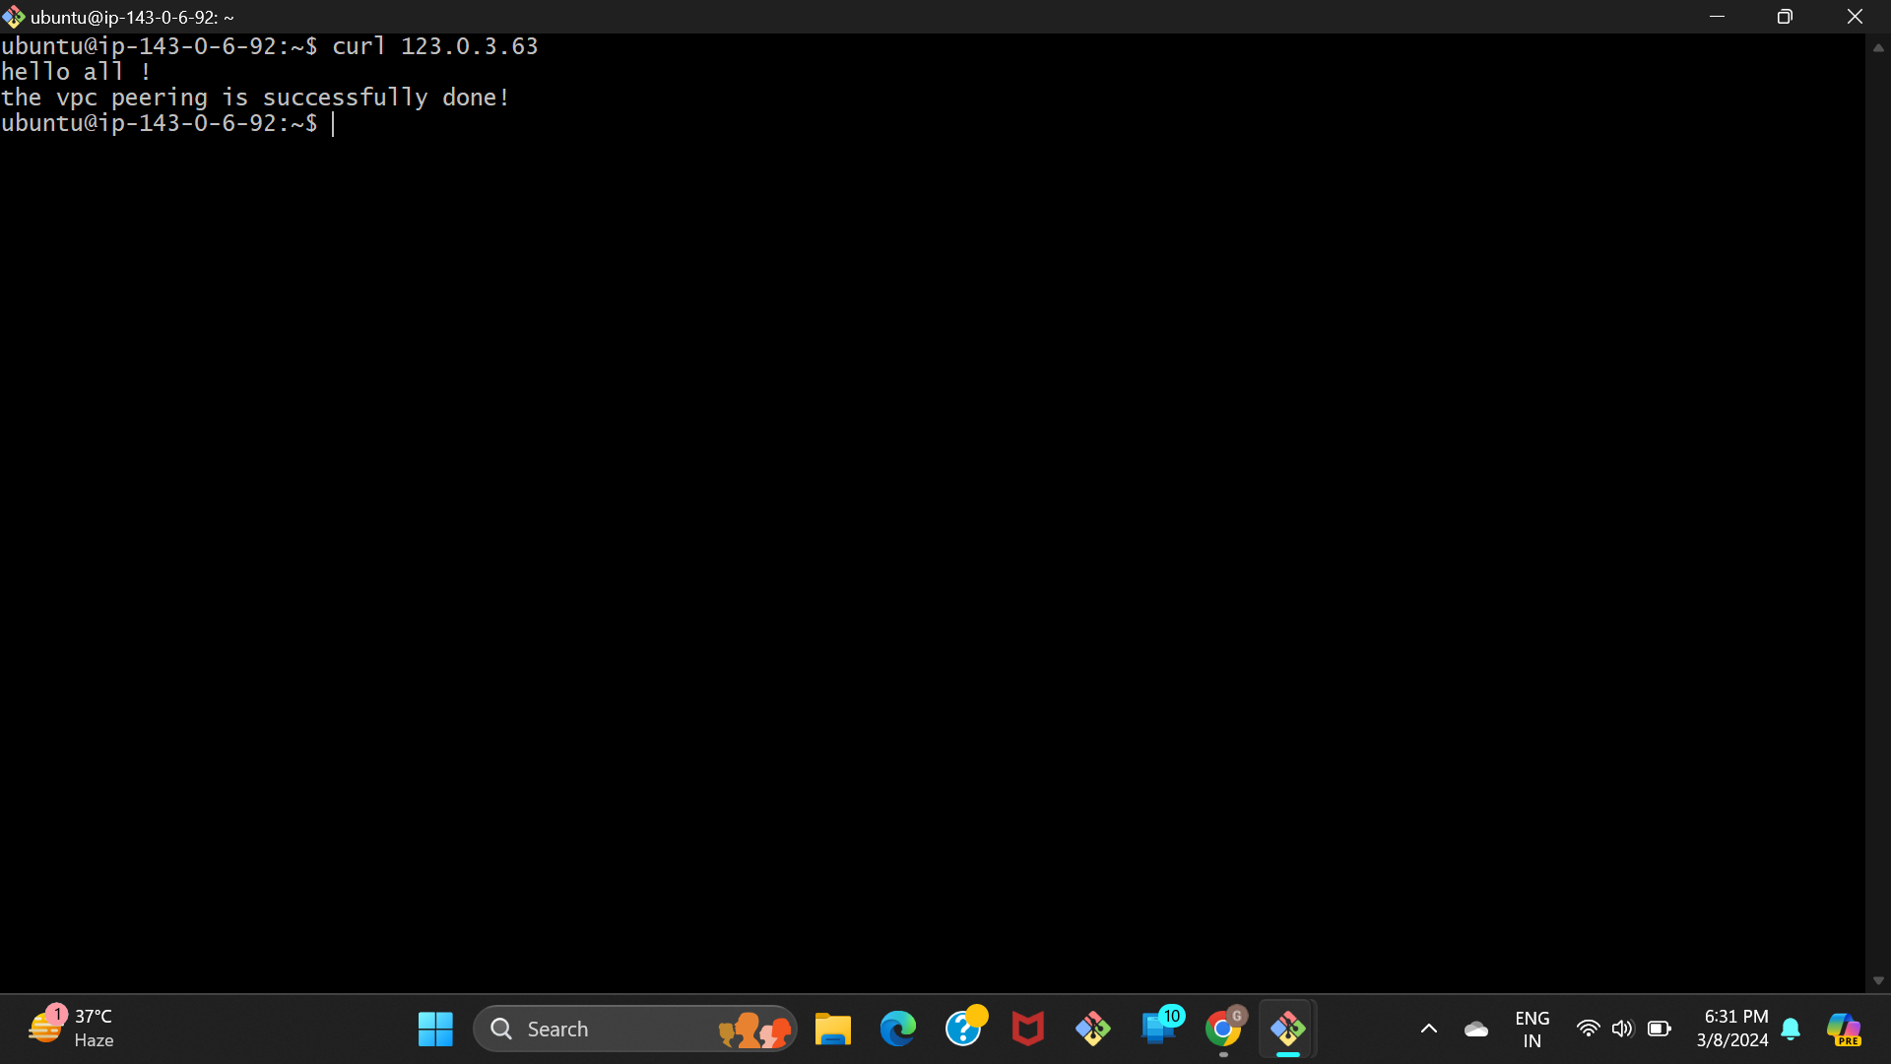
Step 14 :- In the end connect any one of the ec2 instance and run the command curl <another ec2 private ip> .

